Slide 1

數位控制系統期末專題 – Final Project Report Lateral Dynamic Control of a Civil Passenger Aircraft with Discrete LQR Controller
組員
R07921006 楊軒昱
R07921012 張峻豪

Slide 2
Outline
Part 1. References
Part 2. Introduction
Problem formulation
System Assumption
Aircraft System Description
Controllability and Observability
Part 3. Continuous Time system
Continuous Time Controller
Simulation Performance
Part 4. Discrete Time system
Zero-Order Hold Emulation Design
Plant Variables
Simulation Performance
First-Order Hold Emulation Design
Plant Variables
Simulation Performance
Part 5. Summary of Simulation

Slide 3
Part 1. References

Slide 4
References
[1: Ashraf et al. 2018]
Adnan Ashraf1, Wu Mei, Liu Gaoyuan, Zeeshan Anjum and Mian Muhammad Kamal , “Design Linear Feedback and LQR Controller for Lateral Flight Dynamics of F-16 Aircraft,” in Proceedings of International Conference On Control Automation & Information Sciences (ICCAIS), Hangzhou, China, pp. 367~371, October 24-27, 2018.
[2: Livet et al. 1994]
T. Livet, F. Kubica and J.F Magni , “Performance improvement by feedforward: application to civil aircraft control design,” in Proceedings of IEEE International Conference on Control and Applications, Glasgow, UK, Aug. 24-26, 1994.
[3: Liu & Jiao 2010]
A. Schirrer, C. Westermayer, M. Hemedi and M. Kozek, “LQ-based design of the inner loop lateral control for a large flexible BWB-type aircraft,” in International Conference on Control Applications, Yokohama, Japan, Sep. 8-10, 2010.

Slide 5
References
[4: Usta et al. 2011]
M. Ali Usta, Ömür Akyazı and A. Sefa Akpınar , “Aircraft roll control system using LQR and fuzzy logic controller,” in International Symposium on Innovations in Intelligent Systems and Applications, Istanbul, Turkey, pp. 367~371, Jun. 15-18, 2011.
[5: Bai & Dong 2013]
Bin Bai and Chaoyang Dong, "Modeling and LQR Switch Control of Morphing Aircraft," in International Symposium on Computational Intelligence and Design, Hangzhou, China, Oct. 28-29, 2013.
[6: Rajeswari & Suresh 2015]
V. Rajeswari and L.Padma Suresh, “Comparative Assessment of the performances of Linear Quadratic and Sliding Mode Control Methodologies in the Control of Lateral Axis of Aircraft,” in Proceedings of International Conference on Circuit, Power and Computing Technologies (ICCPCT), Cebu, Philipines, pp. 1-6, March 27-28, 2015.

Slide 6
References
[7: Wang et al. 2016]
Kangle Wang, Shaoping Wang, Xingjian Wang and Zhongwei Yang, “Active fault-tolerant control strategy for lateral motion of civil aircraft,” in IEEE International Conference on Aircraft Utility Systems (AUS), Beijing, China, Oct. 10-12, 2016.
[8: Liu & Jiao 2017]
Baoxu Liu and Zongxia Jiao, “LQR Lateral-Directional Control Law Design for Distributed Propulsion Layout Flying Wing,” in Proceedings of IEEE International Conference on CIS & RAM, Ningbo, China, pp. 715~719, Nov. 19-21, 2017 .
[9: Hasan & Khan 2018]
Ehtisham ul Hasan and Amna Khan, "Lateral acceleration control of aircraft using PID, linear quadratic regulator (LQR) and linear quadratic integral (LQI); A comparative case study," in International Conference on Electrical and Electronic Engineering (ICEEE), Istanbul, Turkey, May 3-5, 2018.
[10: Shin et al. 1985]
K.G. Shin, C.M. Krishna, Y.-H. Lee, "A unified method for evaluating real-time computer controllers and its applications," IEEE Transactions Automatic Control, Vol. 30, No. 4, pp. 357-366, April 1985.

Slide 7
Part 2. Introduction

Slide 8
Introduction
The dynamics of many aircraft can be modeled as two sets of essentially decoupled multivariable systems.
The first subsystem is called the longitudinal dynamics.
The second subsystem is called the lateral dynamics, which is our simulation topic of this project.
The lateral dynamics concerns the motion of the craft in roll and yaw caused by the action of the ailerons and rudder.

Slide 9
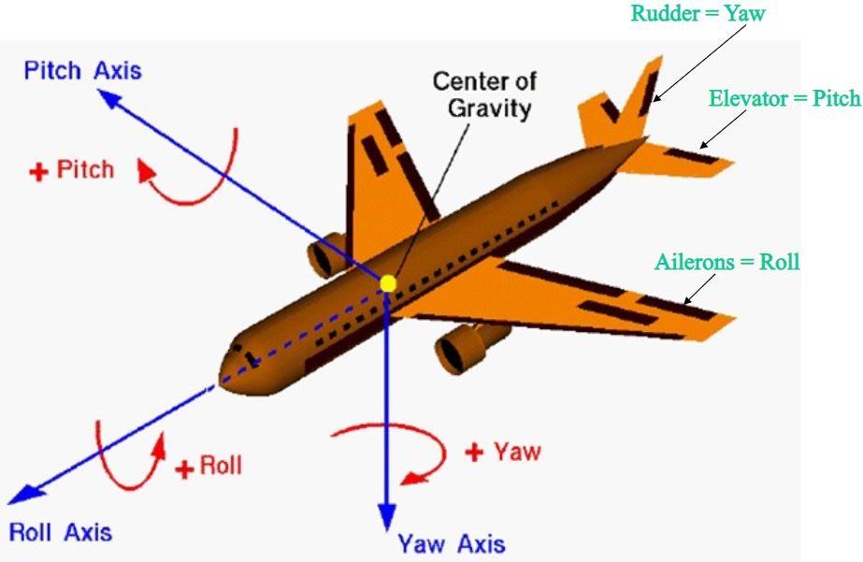
Introduction (Cont.)
The lateral dynamics are further subdivided into two parts:
Roll dynamics: roll rate and roll angle
Yaw dynamics: yaw rate and side-slip rate
Fig. An aircraft angle control system.
[Ref: https://slideplayer.com/slide/4569242/]

Slide 10
Problem formulation
We want to design the controllers for the lateral dynamics of an A340 airline in normal cruise flight.
First, we establish a continuous time system model
The control method we used in this project is state feedback control (SFC).
The controller of the model was designed by using LQR control. [1: Ashraf et al. 2018]
The continuous model is regarded as the ground truth when comparing with the discrete time system model.
Then, we discretized the continuous system with different sampling time and sampling methods.
After that, we design the controllers of the discrete time system model in different situation and compare the performance with continuous time system model.

Slide 11
System Assumption
There is no coupling between the lateral dynamics and the longitudinal dynamics.
The rudder and aileron deflections are limited to approximately to ±10°.
The plant dynamics are only estimated of the actual value. (The numerical values are referred to the homework of linear system theory)

Slide 12
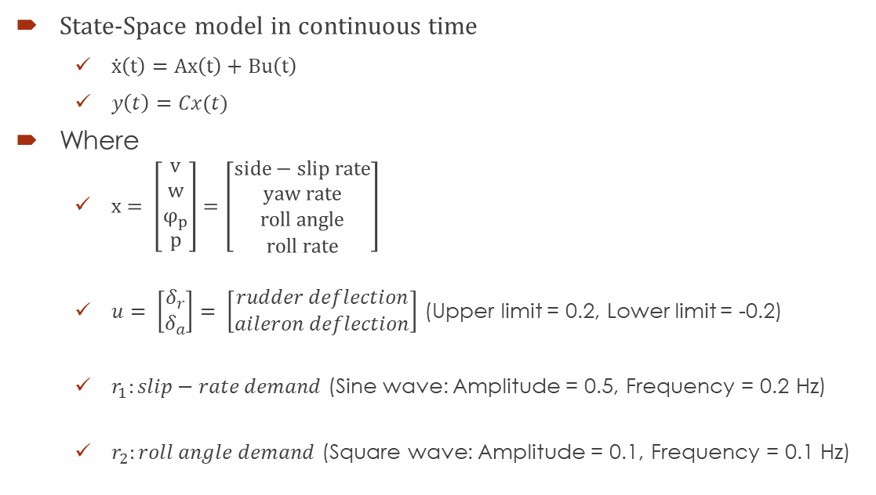
Aircraft System Description
State-Space model in continuous time
$\dot{x}\left(t\right)=Ax\left(t\right)+Bu\left(t\right)$
$y\left(t\right)=Cx(t)$
Where
$x= \left[\begin{matrix}v \\ w \\ φ_{p} \\ p\end{matrix}\right]=\left[\begin{matrix}side−slip rate \\ yaw rate \\ roll angle \\ roll rate\end{matrix}\right]$
$u= \left[\begin{matrix}δ_{r} \\ δ_{a}\end{matrix}\right]= \left[\begin{matrix}rudder deflection \\ aileron deflection\end{matrix}\right]$ (Upper limit = 0.2, Lower limit = -0.2)
$r_{1}:slip−rate demand$ (Sine wave: Amplitude = 0.5, Frequency = 0.2 Hz)
$r_{2}:roll angle demand$ (Square wave: Amplitude = 0.1, Frequency = 0.1 Hz)
The limit of rudder and aileron deflections are ± 10°, which is approximately ± 0.2 rad.

Slide 13
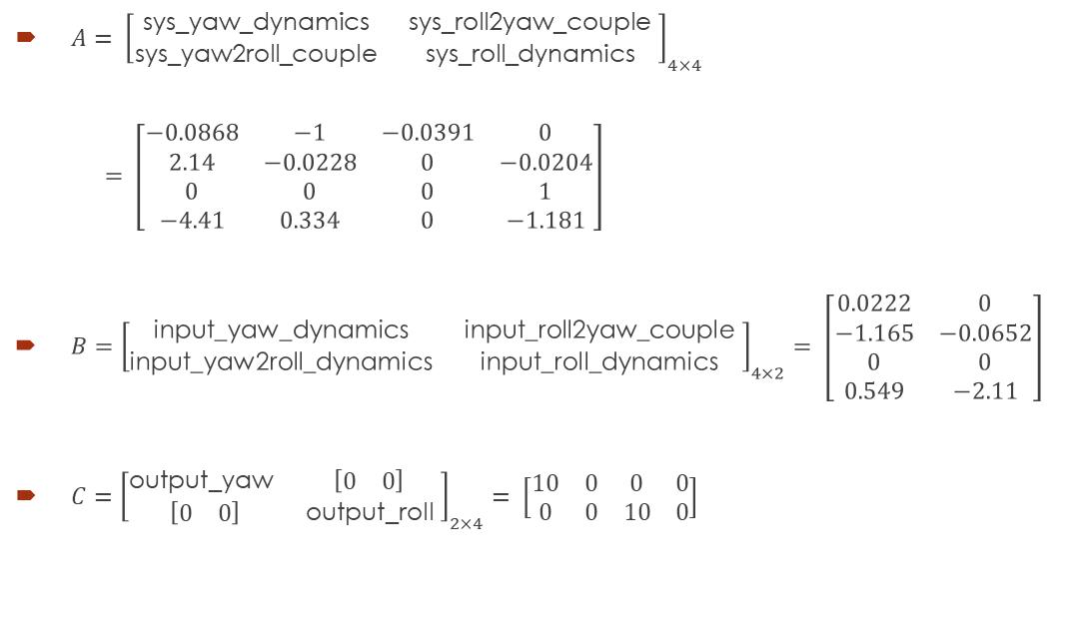
Aircraft System Description (Cont.)
$A= {\left[\begin{matrix}\text{sys}\text{_}\text{yaw}\text{_}\text{dynamics} & \text{sys}\text{_}\text{roll}\text{2}\text{yaw}\text{_}\text{couple} \\ \text{sys}\text{_}\text{yaw}\text{2}\text{roll}\text{_}\text{couple} & \text{sys}\text{_}\text{roll}\text{_}\text{dynamics} \end{matrix}\right]}_{4×4}$
$= \left[\begin{matrix}−0.0868 & −1 & −0.0391 & 0 \\ 2.14 & −0.0228 & 0 & −0.0204 \\ 0 & 0 & 0 & 1 \\ −4.41 & 0.334 & 0 & −1.181\end{matrix}\right]$
$B={\left[\begin{matrix}\text{input}\text{_}\text{yaw}\text{_}\text{dynamics} & \text{input}\text{_}\text{roll}\text{2}\text{yaw}\text{_}\text{couple} \\ \text{input}\text{_}\text{yaw}\text{2}\text{roll}\text{_}\text{dynamics} & \text{input}\text{_}\text{roll}\text{_}\text{dynamics} \end{matrix}\right]}_{4×2}= \left[\begin{matrix}0.0222 & 0 \\ −1.165 & −0.0652 \\ 0 & 0 \\ 0.549 & −2.11\end{matrix}\right]$
$C={\left[\begin{matrix}\text{output}\text{_}\text{yaw} & \left[\begin{matrix}0 & 0\end{matrix}\right] \\ \left[\begin{matrix}0 & 0\end{matrix}\right] & \text{output}\text{_}\text{roll} \end{matrix}\right]}_{2×4}= \left[\begin{matrix}10 & 0 & 0 & 0 \\ 0 & 0 & 10 & 0\end{matrix}\right]$

Slide 14
Stability, Controllability and Observability
To check the stability, controllability and observability of the system, we can use MATLAB command rank(A), ctrb(A,B) and obsv(A,C), respectively.
rank(A) = 4 → The matrix is full rank → The system is stable
rank(ctrb(A,B)) = 4 = rank(A) → The matrix is full rank → The system is controllable
rank(obsv(A,C)) = 4 = rank(A) → The matrix is full rank → The system is observable

Slide 15
Part 3. Continuous Time System

Slide 16
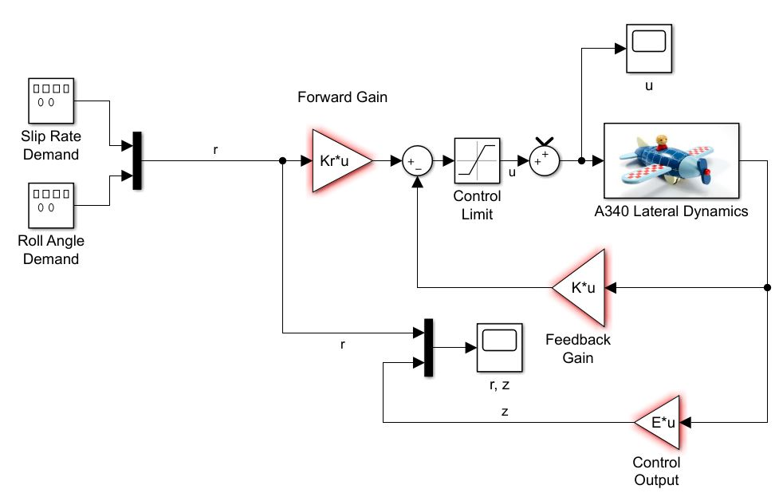
Continuous time system (SFC)
Controllers to be designed
The controlled output z is the same as the measured output y, so that in the standard notation E=C.

Slide 17
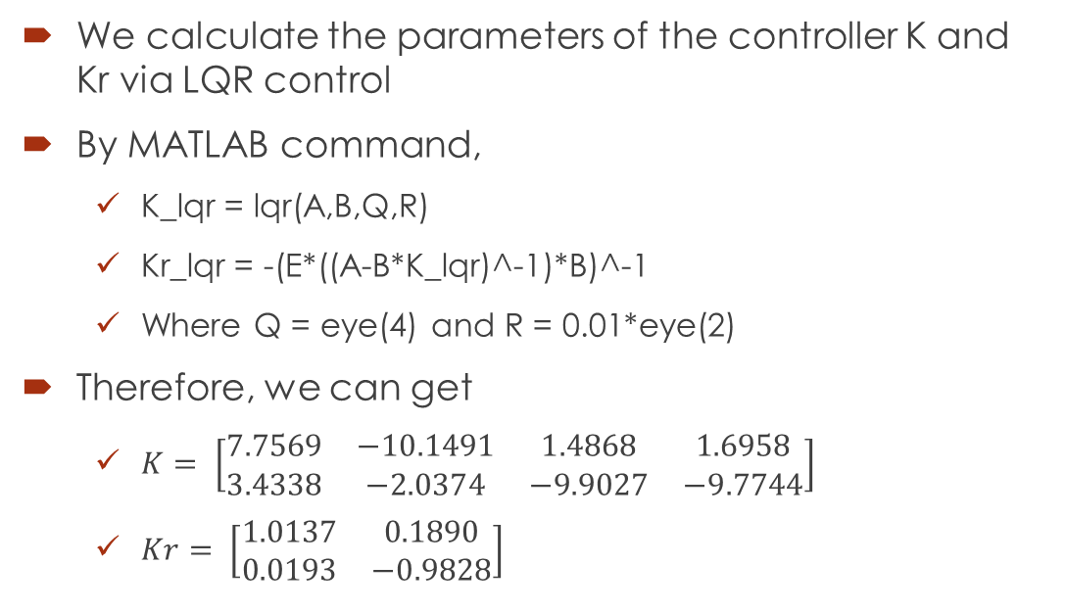
Continuous time controller
We calculate the parameters of the controller K and Kr via LQR control
By MATLAB command,
K_lqr = lqr(A,B,Q,R)
Kr_lqr = -(E*((A-B*K_lqr)^-1)*B)^-1
Where Q = eye(4) and R = 0.01*eye(2)
Therefore, we can get
$K= \left[\begin{matrix}7.7569 & −10.1491 & 1.4868 & 1.6958 \\ 3.4338 & −2.0374 & −9.9027 & −9.7744\end{matrix}\right]$
$Kr= \left[\begin{matrix}1.0137 & 0.1890 \\ 0.0193 & −0.9828\end{matrix}\right]$

Slide 18
Lateral Velocity Results in Continuous Time
Fig. Control Input
(upper bound: 0.2, lower bound: -0.2)
Fig. Reference (Yellow dotted line) and Output state (White)
Reference: sin wave (magnitude: 0.5 , Frequency: 0.05)
State Initial condition: -2

Slide 19
Roll Angle Results in Continuous Time
Fig. Control Input
(upper bound: 0.2, lower bound: -0.2)
Fig. Reference (Yellow dotted line) and Output state (White)
Reference: square wave (magnitude: 0.1 , Frequency: 0.1)
State Initial condition: 1

Slide 20
Part 4. Discrete Time system

Slide 21
Zero-Order Hold Emulation Design

Slide 22
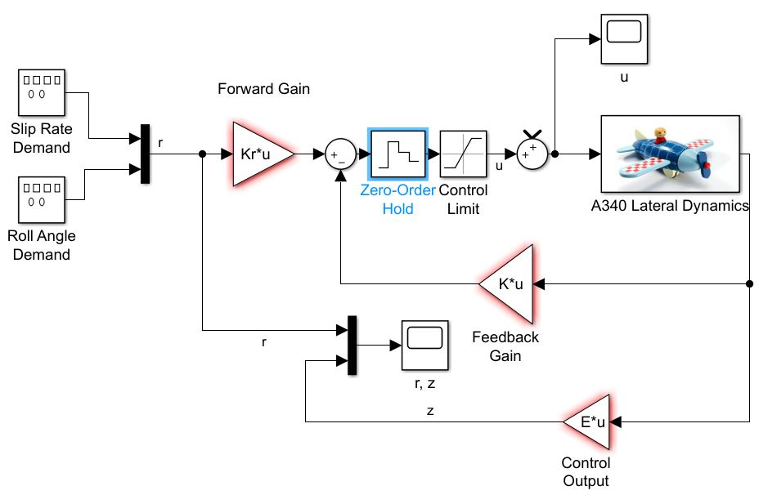
Discrete time system (ZOH)
Zero-Order hold is added

Slide 23
Plant Discretization and Discrete Controller
We can discretize the system and design the discrete time controllers by the following MATLAB command:
Ts = 0.2; % Setting sampling time h
sys = ss(A, B, C, []); % State-space model in continuous time
sys = c2d(sys,Ts, ‘zoh'); % Transform the continuous system into discrete form in h
[F,H,C_dis,D_dis] = ssdata(sys); % Obtain the discrete state-space model
K_lqr_dis = lqrd(A,B,Q,R, Ts); % Discrete model lqr
Kr_lqr_dis = -(E*((A-B*K_lqr_dis)^-1)*B)^-1 % Discrete model lqr

Slide 24
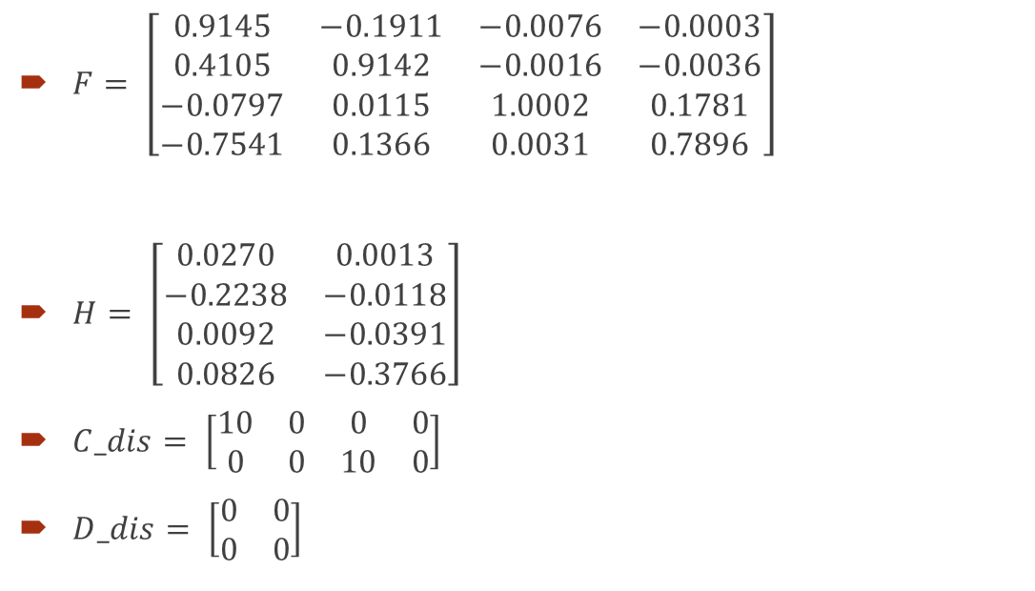

Discretized Plant (ZOH, Ts = 0.2s)
$F= \left[\begin{matrix}0.9145 & −0.1911 & −0.0076 & −0.0003 \\ 0.4105 & 0.9142 & −0.0016 & −0.0036 \\ −0.0797 & 0.0115 & 1.0002 & 0.1781 \\ −0.7541 & 0.1366 & 0.0031 & 0.7896\end{matrix}\right]$
$H= \left[\begin{matrix}0.0270 & 0.0013 \\ −0.2238 & −0.0118 \\ 0.0092 & −0.0391 \\ 0.0826 & −0.3766\end{matrix}\right]$
$C_dis= \left[\begin{matrix}10 & 0 & 0 & 0 \\ 0 & 0 & 10 & 0\end{matrix}\right]$
$D_dis= \left[\begin{matrix}0 & 0 \\ 0 & 0\end{matrix}\right]$
$$K_lqr_dis= \left[\begin{matrix}1.9440 & −4.2528 & 0.1604 & 0.2529 \\ 2.4279 & −1.2371 & −2.7364 & −2.6300\end{matrix}\right]$$
$$Kr_lqr_dis= \left[\begin{matrix}0.4065 & 0.0334 \\ −0.0888 & −0.2693\end{matrix}\right]$$

Slide 25
Stability, Controllability and Observability
To check the stability, controllability and observability of the system, we can use MATLAB command rank(F), ctrb(F,H) and obsv(F,C_dis), respectively.
rank(F) = 4 → The matrix is full rank → The system is stable
rank(ctrb(F,H)) = 4 = rank(F) → The matrix is full rank → The system is controllable
rank(obsv(F,C_dis)) = 4 = rank(F) → The matrix is full rank → The system is observable

Slide 26
Lateral Velocity Results in Sampling Time = 0.2 sec
Fig. Control Input
(upper bound: 0.2, lower bound: -0.2)
Fig. Reference (Yellow dotted line) and Output state (Red)
Reference: sin wave (magnitude: 0.5 , Frequency: 0.05)
State Initial condition: -2

Slide 27
Roll Angle Results in Sampling Time = 0.2 sec
Fig. Control Input
(upper bound: 0.2, lower bound: -0.2)
Fig. Reference (Yellow dotted line) and Output state (Red)
Reference: square wave (magnitude: 0.1 , Frequency: 0.1)
State Initial condition: 1

Slide 28

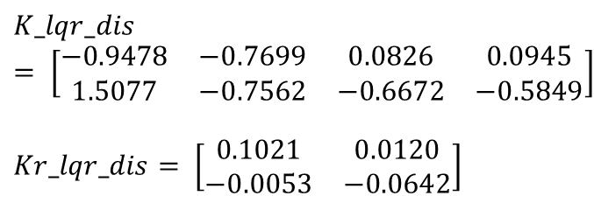
Discretized Plant (ZOH, Ts = 1.0s)
$F= \left[\begin{matrix}0.1426 & −0.5841 & −0.0262 & −0.0057 \\ 1.2700 & 0.0406 & −0.0320 & −0.0150 \\ −1.1516 & 0.5488 & 1.0184 & 0.5822 \\ −1.3197 & 1.2230 & 0.0450 & 0.3124\end{matrix}\right]$
$H= \left[\begin{matrix}0.4541 & 0.0293 \\ −0.6974 & 0.0233 \\ −0.0097 & −0.7495 \\ −0.3420 & −1.2770\end{matrix}\right]$
$C_dis= \left[\begin{matrix}10 & 0 & 0 & 0 \\ 0 & 0 & 10 & 0\end{matrix}\right]$
$D_dis= \left[\begin{matrix}0 & 0 \\ 0 & 0\end{matrix}\right]$
$$K_lqr_dis= \left[\begin{matrix}−0.9478 & −0.7699 & 0.0826 & 0.0945 \\ 1.5077 & −0.7562 & −0.6672 & −0.5849\end{matrix}\right]$$
$$Kr_lqr_dis= \left[\begin{matrix}0.1021 & 0.0120 \\ −0.0053 & −0.0642\end{matrix}\right]$$

Slide 29
Stability, Controllability and Observability
To check the stability, controllability and observability of the system, we can use MATLAB command rank(F), ctrb(F,H) and obsv(F,C_dis), respectively.
rank(F) = 4 → The matrix is full rank → The system is stable
rank(ctrb(F,H)) = 4 = rank(F) → The matrix is full rank → The system is controllable
rank(obsv(F,C_dis)) = 4 = rank(F) → The matrix is full rank → The system is observable

Slide 30
Lateral Velocity Results in Sampling Time = 1.0 sec
Fig. Control Input
(upper bound: 0.2, lower bound: -0.2)
Fig. Reference (Yellow dotted line) and Output state (Blue)
Reference: sin wave (magnitude: 0.5 , Frequency: 0.05)
State Initial condition: -2

Slide 31
Roll Angle Results in Sampling Time = 1.0 sec
Fig. Control Input
(upper bound: 0.2, lower bound: -0.2)
Fig. Reference (Yellow dotted line) and Output state (Blue)
Reference: square wave (magnitude: 0.1 , Frequency: 0.1)
State Initial condition: 1

Slide 32
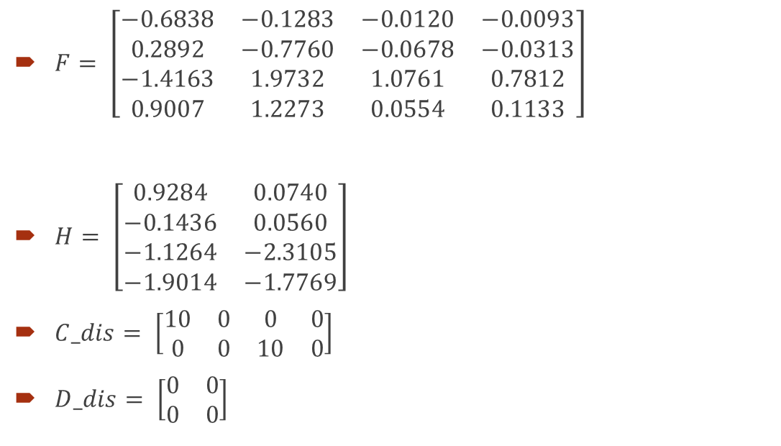
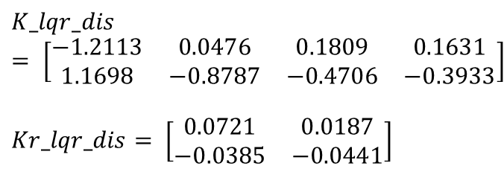
Discretized Plant (ZOH, Ts = 2.0s)
$F= \left[\begin{matrix}−0.6838 & −0.1283 & −0.0120 & −0.0093 \\ 0.2892 & −0.7760 & −0.0678 & −0.0313 \\ −1.4163 & 1.9732 & 1.0761 & 0.7812 \\ 0.9007 & 1.2273 & 0.0554 & 0.1133\end{matrix}\right]$
$H= \left[\begin{matrix}0.9284 & 0.0740 \\ −0.1436 & 0.0560 \\ −1.1264 & −2.3105 \\ −1.9014 & −1.7769\end{matrix}\right]$
$C_dis= \left[\begin{matrix}10 & 0 & 0 & 0 \\ 0 & 0 & 10 & 0\end{matrix}\right]$
$D_dis= \left[\begin{matrix}0 & 0 \\ 0 & 0\end{matrix}\right]$
$$K_lqr_dis= \left[\begin{matrix}−1.2113 & 0.0476 & 0.1809 & 0.1631 \\ 1.1698 & −0.8787 & −0.4706 & −0.3933\end{matrix}\right]$$
$$Kr_lqr_dis= \left[\begin{matrix}0.0721 & 0.0187 \\ −0.0385 & −0.0441\end{matrix}\right]$$

Slide 33
Stability, Controllability and Observability
To check the stability, controllability and observability of the system, we can use MATLAB command rank(F), ctrb(F,H) and obsv(F,C_dis), respectively.
rank(F) = 4 → The matrix is full rank → The system is stable
rank(ctrb(F,H)) = 4 = rank(F) → The matrix is full rank → The system is controllable
rank(obsv(F,C_dis)) = 4 = rank(F) → The matrix is full rank → The system is observable

Slide 34
Lateral Velocity Results in Sampling Time = 2.0 sec
Fig. Control Input
(upper bound: 0.2, lower bound: -0.2)
Fig. Reference (Yellow dotted line) and Output state (Green)
Reference: sin wave (magnitude: 0.5 , Frequency: 0.05)
State Initial condition: -2

Slide 35
Roll Angle Results in Sampling Time = 2.0 sec
Fig. Control Input
(upper bound: 0.2, lower bound: -0.2)
Fig. Reference (Yellow dotted line) and Output state (Green)
Reference: square wave (magnitude: 0.1 , Frequency: 0.1)
State Initial condition: 1

Slide 36
Lateral Velocity Results in Different Sampling Time
Reference: sin wave (magnitude: 0.5 , Frequency: 0.05)
State Initial condition: -2
Continuous Time
Sampling Time = 0.2 s
Sampling Time = 1 s
Sampling Time = 2 s

Slide 37
Lateral Velocity Results in Different Sampling Time (Cont.)
White line for continuous time
Red line for sampling time = 0.2 sec
Blue line for sampling time = 1.0 sec
green line for Sampling time = 2.0 sec

Slide 38
Roll Angle Results in Different Sampling Time
Reference: square wave (magnitude: 0.1 , Frequency: 0.1)
State Initial condition: 1
Continuous Time
Sampling Time = 0.2 s
Sampling Time = 1 s
Sampling Time = 2 s

Slide 39
Roll Angle Results in Different Sampling Time (Cont.)
White line for continuous time
Red line for sampling time = 0.2 sec
Blue line for sampling time = 1.0 sec
green line for Sampling time = 2.0 sec

Slide 40
First-Order Hold Emulation Design

Slide 41
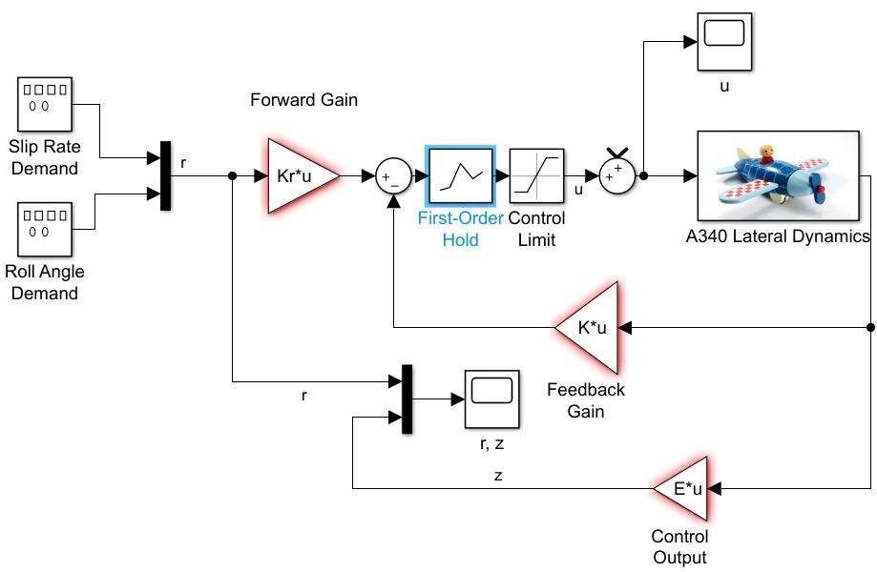
Discrete time system (FOH)
First-Order hold is added

Slide 42
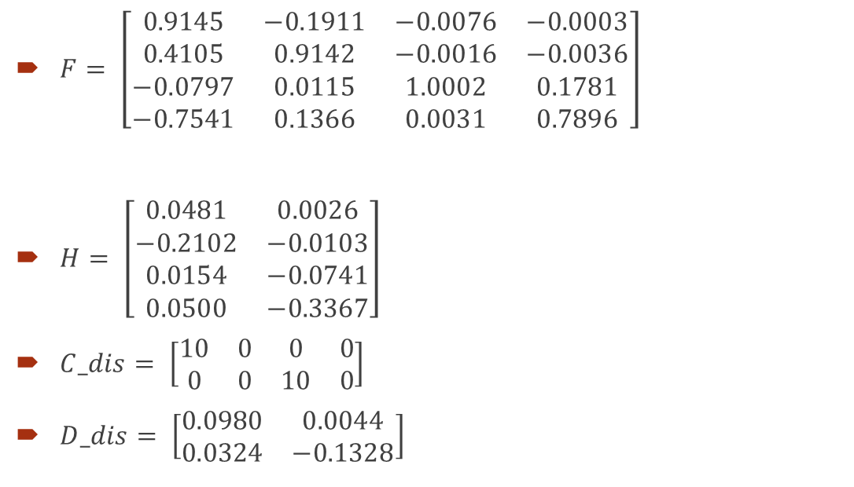

Discretized Plant (FOH, Ts = 0.2s)
$F= \left[\begin{matrix}0.9145 & −0.1911 & −0.0076 & −0.0003 \\ 0.4105 & 0.9142 & −0.0016 & −0.0036 \\ −0.0797 & 0.0115 & 1.0002 & 0.1781 \\ −0.7541 & 0.1366 & 0.0031 & 0.7896\end{matrix}\right]$
$H= \left[\begin{matrix}0.0481 & 0.0026 \\ −0.2102 & −0.0103 \\ 0.0154 & −0.0741 \\ 0.0500 & −0.3367\end{matrix}\right]$
$C_dis= \left[\begin{matrix}10 & 0 & 0 & 0 \\ 0 & 0 & 10 & 0\end{matrix}\right]$
$D_dis= \left[\begin{matrix}0.0980 & 0.0044 \\ 0.0324 & −0.1328\end{matrix}\right]$
$$K_lqr_dis= \left[\begin{matrix}1.9440 & −4.2528 & 0.1604 & 0.2529 \\ 2.4279 & −1.2371 & −2.7364 & −2.6300\end{matrix}\right]$$
$$Kr_lqr_dis= \left[\begin{matrix}0.4065 & 0.0334 \\ −0.0888 & −0.2693\end{matrix}\right]$$

Slide 43
Stability, Controllability and Observability
To check the stability, controllability and observability of the system, we can use MATLAB command rank(F), ctrb(F,H) and obsv(F,C_dis), respectively.
rank(F) = 4 → The matrix is full rank → The system is stable
rank(ctrb(F,H)) = 4 = rank(F) → The matrix is full rank → The system is controllable
rank(obsv(F,C_dis)) = 4 = rank(F) → The matrix is full rank → The system is observable

Slide 44
Lateral Velocity Results in Sampling Time = 0.2 sec
Fig. Control Input
(upper bound: 0.2, lower bound: -0.2)
Fig. Reference (Yellow dotted line) and Output state (Red)
Reference: sin wave (magnitude: 0.5 , Frequency: 0.05)
State Initial condition: -2

Slide 45
Roll Angle Results in Sampling Time = 0.2 sec
Fig. Control Input
(upper bound: 0.2, lower bound: -0.2)
Fig. Reference (Yellow dotted line) and Output state (Red)
Reference: square wave (magnitude: 0.1 , Frequency: 0.1)
State Initial condition: 1

Slide 46
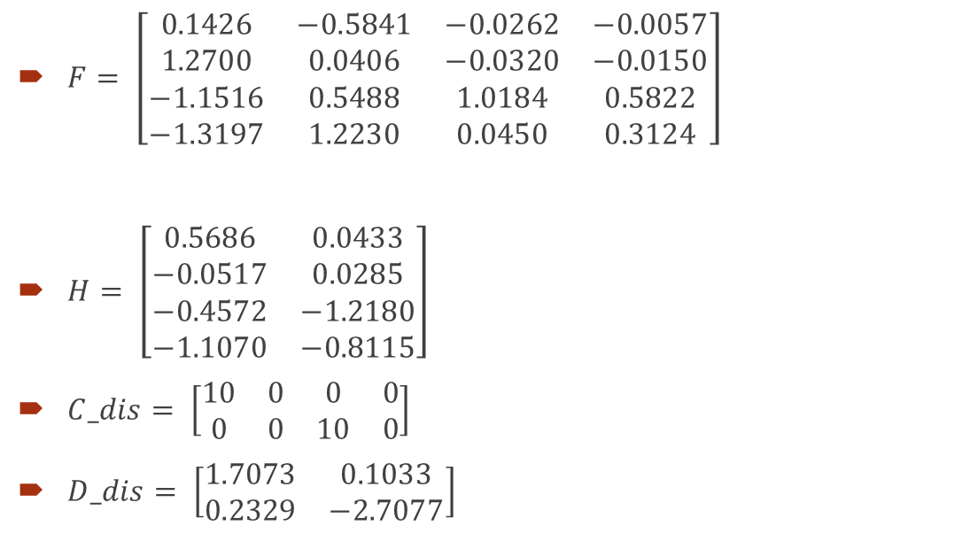
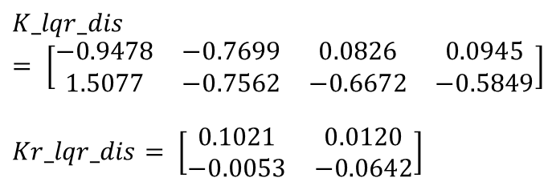
Discretized Plant (FOH, Ts = 1.0s)
$F= \left[\begin{matrix}0.1426 & −0.5841 & −0.0262 & −0.0057 \\ 1.2700 & 0.0406 & −0.0320 & −0.0150 \\ −1.1516 & 0.5488 & 1.0184 & 0.5822 \\ −1.3197 & 1.2230 & 0.0450 & 0.3124\end{matrix}\right]$
$H= \left[\begin{matrix}0.5686 & 0.0433 \\ −0.0517 & 0.0285 \\ −0.4572 & −1.2180 \\ −1.1070 & −0.8115\end{matrix}\right]$
$C_dis= \left[\begin{matrix}10 & 0 & 0 & 0 \\ 0 & 0 & 10 & 0\end{matrix}\right]$
$D_dis= \left[\begin{matrix}1.7073 & 0.1033 \\ 0.2329 & −2.7077\end{matrix}\right]$
$$K_lqr_dis= \left[\begin{matrix}−0.9478 & −0.7699 & 0.0826 & 0.0945 \\ 1.5077 & −0.7562 & −0.6672 & −0.5849\end{matrix}\right]$$
$$Kr_lqr_dis= \left[\begin{matrix}0.1021 & 0.0120 \\ −0.0053 & −0.0642\end{matrix}\right]$$

Slide 47
Stability, Controllability and Observability
To check the stability, controllability and observability of the system, we can use MATLAB command rank(F), ctrb(F,H) and obsv(F,C_dis), respectively.
rank(F) = 4 → The matrix is full rank → The system is stable
rank(ctrb(F,H)) = 4 = rank(F) → The matrix is full rank → The system is controllable
rank(obsv(F,C_dis)) = 4 = rank(F) → The matrix is full rank → The system is observable

Slide 48
Lateral Velocity Results in Sampling Time = 1.0 sec
Fig. Control Input
(upper bound: 0.2, lower bound: -0.2)
Fig. Reference (Yellow dotted line) and Output state (Blue)
Reference: sin wave (magnitude: 0.5 , Frequency: 0.05)
State Initial condition: -2

Slide 49
Roll Angle Results in Sampling Time = 1.0 sec
Fig. Control Input
(upper bound: 0.2, lower bound: -0.2)
Fig. Reference (Yellow dotted line) and Output state (Blue)
Reference: square wave (magnitude: 0.1 , Frequency: 0.1)
State Initial condition: 1

Slide 50
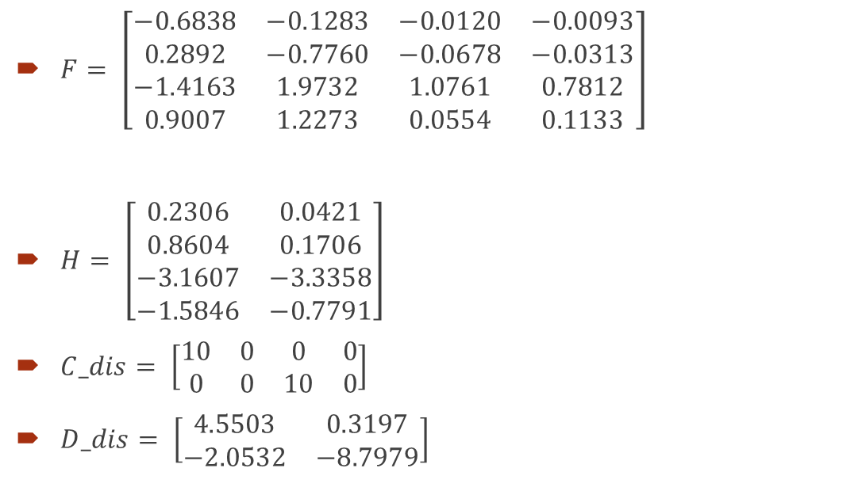
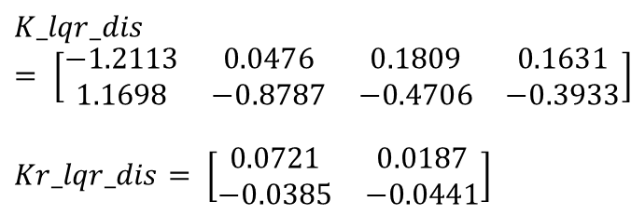
Discretized Plant (FOH, Ts = 2.0s)
$F= \left[\begin{matrix}−0.6838 & −0.1283 & −0.0120 & −0.0093 \\ 0.2892 & −0.7760 & −0.0678 & −0.0313 \\ −1.4163 & 1.9732 & 1.0761 & 0.7812 \\ 0.9007 & 1.2273 & 0.0554 & 0.1133\end{matrix}\right]$
$H= \left[\begin{matrix}0.2306 & 0.0421 \\ 0.8604 & 0.1706 \\ −3.1607 & −3.3358 \\ −1.5846 & −0.7791\end{matrix}\right]$
$C_dis= \left[\begin{matrix}10 & 0 & 0 & 0 \\ 0 & 0 & 10 & 0\end{matrix}\right]$
$D_dis= \left[\begin{matrix}4.5503 & 0.3197 \\ −2.0532 & −8.7979\end{matrix}\right]$
$$K_lqr_dis= \left[\begin{matrix}−1.2113 & 0.0476 & 0.1809 & 0.1631 \\ 1.1698 & −0.8787 & −0.4706 & −0.3933\end{matrix}\right]$$
$$Kr_lqr_dis= \left[\begin{matrix}0.0721 & 0.0187 \\ −0.0385 & −0.0441\end{matrix}\right]$$

Slide 51
Stability, Controllability and Observability
To check the stability, controllability and observability of the system, we can use MATLAB command rank(F), ctrb(F,H) and obsv(F,C_dis), respectively.
rank(F) = 4 → The matrix is full rank → The system is stable
rank(ctrb(F,H)) = 4 = rank(F) → The matrix is full rank → The system is controllable
rank(obsv(F,C_dis)) = 4 = rank(F) → The matrix is full rank → The system is observable

Slide 52
Lateral Velocity Results in Sampling Time = 2.0 sec
Fig. Control Input
(upper bound: 0.2, lower bound: -0.2)
Fig. Reference (Yellow dotted line) and Output state (Green)
Reference: sin wave (magnitude: 0.5 , Frequency: 0.05)
State Initial condition: -2

Slide 53
Roll Angle Results in Sampling Time = 2.0 sec
Fig. Control Input
(upper bound: 0.2, lower bound: -0.2)
Fig. Reference (Yellow dotted line) and Output state (Blue)
Reference: square wave (magnitude: 0.1 , Frequency: 0.1)
State Initial condition: 1

Slide 54
Lateral Velocity Results in Different Sampling Time
Reference: sin wave (magnitude: 0.5 , Frequency: 0.05)
State Initial condition: -2
Continuous Time
Sampling Time = 0.2 s
Sampling Time = 1 s
Sampling Time = 2 s

Slide 55
Roll Angle Results in Different Sampling Time (Cont.)
White line for continuous time
Red line for sampling time = 0.2 sec
Blue line for sampling time = 1.0 sec
green line for Sampling time = 2.0 sec

Slide 56
Roll Angle Results in Different Sampling Time
Reference: square wave (magnitude: 0.1 , Frequency: 0.1)
State Initial condition: 1
Continuous Time
Sampling Time = 0.2 s
Sampling Time = 1 s
Sampling Time = 2 s

Slide 57
Roll Angle Results in Different Sampling Time (Cont.)
Reference Signal sin wave (magnitude: 0.5 , Frequency: 0.05)
State Initial condition: -2
White line for continuous time
Red line for sampling time = 0.2 sec
Blue line for sampling time = 1.0 sec
green line for Sampling time = 2.0 sec

Slide 58
Part 5. Summary of Simulation

Slide 59
Analysis (zoh)
White line for continuous time
Red line for sampling time = 0.2 sec
Blue line for sampling time = 1.0 sec
green line for Sampling time = 2.0 sec
From the results of lateral velocity and roll angle, it is obviously that the shorter the sampling time is, the better the system tracks the reference signal. However, the results of discrete controller can’t still be as good as continuous controller.
Fig. Lateral Velocity Reference and Output State
Fig. Roll Angle Reference and Output state

Slide 60
Analysis (foh)
White line for continuous time
Red line for sampling time = 0.2 sec
Blue line for sampling time = 1.0 sec
green line for Sampling time = 2.0 sec
From the results of lateral velocity and roll angle, we can discover that as the sampling time is shorter, the system tracks the reference signal better. Nonetheless, the results of discrete controller can’t still be as good as continuous controller.
On the other hand, because some of the input signals are cut off by the input constraints when the sampling time = 0.2s, the system output becomes tremble.
Fig. Lateral Velocity Reference and Output State
Fig. Roll Angle Reference and Output state

Slide 61
Comparison of zoh and foh
By comparing the performance of zoh and foh, we can find out that zoh performs better than foh because the input signal is cut off by input constraints in our cases
White line for continuous time
Red line for sampling time = 0.2 sec
Blue line for sampling time = 1.0 sec
green line for Sampling time = 2.0 sec
Fig. Roll Angle Reference and Output State (zoh)
Fig. Roll Angle Reference and Output State (foh)

Slide 62
Comparison of zoh and foh (Cont.)
zoh vs. foh Ref: https://ww2.mathworks.cn/help/control/ref/c2d.html
First-order-hold in MATLAB uses the slope at the sampling instance to fill up the period between the next sampling instance.
Fig. Control Input in continuous time
Fig. Control Input of roll angle control in sampling time = 0.2 s (zoh)
Fig. Control Input of roll angle control in sampling time = 0.2 s (foh)

Slide 63
Comparison of zoh and foh (Cont.)
zoh vs. foh Ref: https://ww2.mathworks.cn/help/control/ref/c2d.html
However, foh might occur severe error if the slope changes dramatically during sampling period with long sampling time.
Thus, zoh performs much better than foh when the sampling time is long.
Fig. Control Input in continuous time
Fig. Control Input of roll angle control in sampling time = 2 s (zoh)
Fig. Control Input of roll angle control in sampling time = 2 s (foh)

